Slide 1
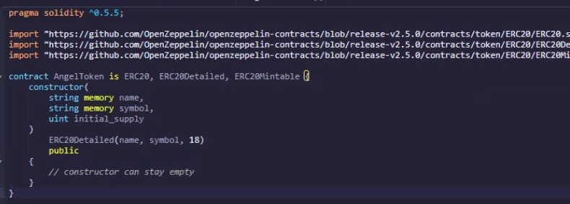
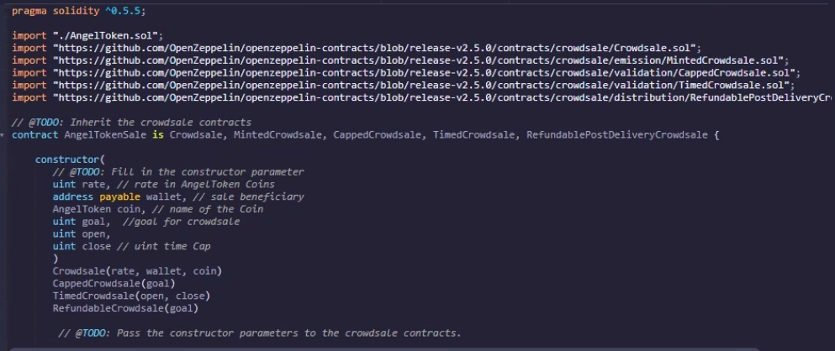
Crowdsale Contract - Angel Company
Syed, Minh, Rodrigo,
Hsuan, Abdullah

Slide 2
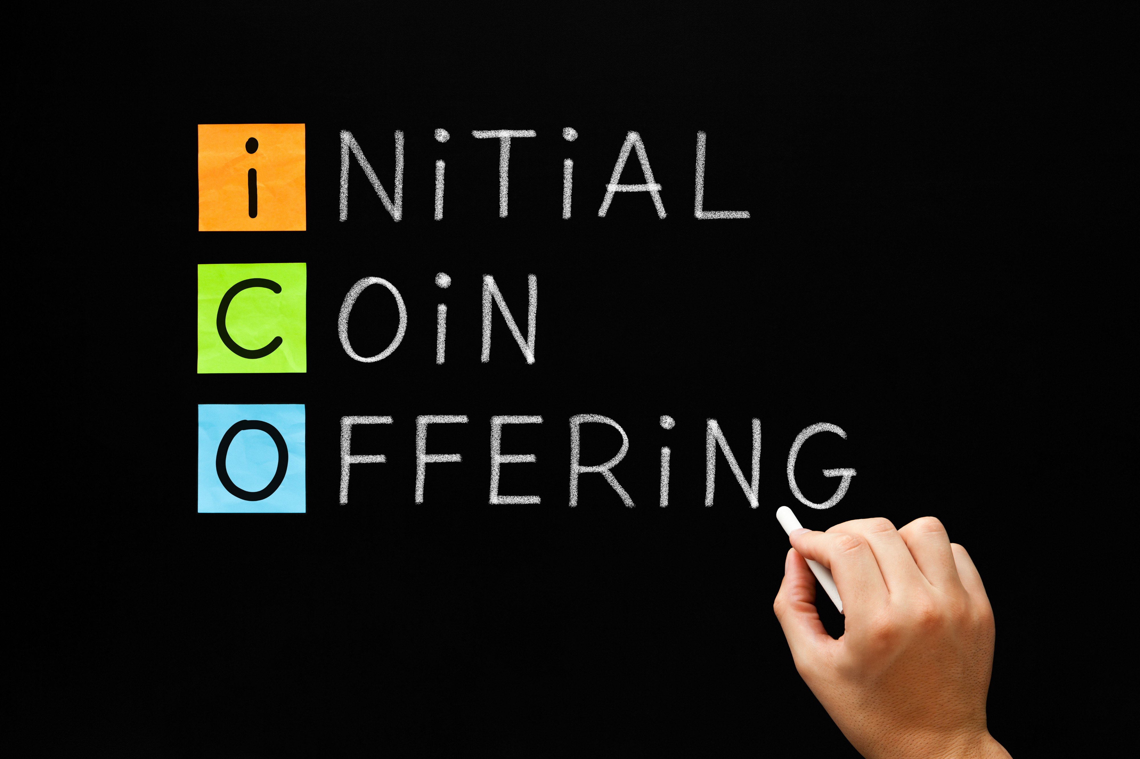
What is Crowdsale contract?
What is Crowdsale contract?
A method of funding a project through the sale of digital tokens that give their buyer the right to participate in an idea being funded by the sale. Not completely regulated by SEC.
A method of funding a project through the sale of digital tokens that give their buyer the right to participate in an idea being funded by the sale.
Why Crowdsale contract?
Why Crowdsale contract?
Hard to raise funds in current primary market (Evidence)
Hard to raise funds in current primary market (Evidence)

Slide 3
Problem Statement and Targets
Problem Statement: We are going to tokenize the asset value(enterprise value) using the proper ERC 20 standard to sell the fungible token – Angel Token. Any company can issue the token to raise funds on our platform. We are not assessing the company but selling the route where people can raise fund.
Target: institutional angel investors and aggressive retail investors who are interested in this fund-raising process.
Our Ultimate Goal: Crowdfunding platforms allow companies to offer the opportunity for investors and allow investors to contribute to angel- or VC-lead rounds, providing a hybrid funding model

Slide 4
Pros & Cons of Crowdsale Contract
Pros
Cons
Provide the freedom to raise what you want, how you want, without the added complications of investors trying to steer your ship
Relatively fast. Most equity crowdfunding platforms give startups 30-60 days to raise investment.
Democratise investment. Democratising investment would prove to be a big attraction for many startups’ founders
Crowdfunding is evolving. Affording founders never-before-seen flexibility to raise capital in a way that suits them.
Restricted Capital. With restrictions imposed on the number of investors you can have, and the amount of capital you can raise (currently capped at $1 mm in the US).
Hidden fees. Common practice for equity crowdfunding platforms to charge fees for facilitation and payment processing.
Easy to trivialise. Without lengthy due diligence or a drawn-out fundraising process, it might be easy to underplay the impact of equity crowdfunding.
Lack of guidance. With most types of equity crowdfunding, you're on your own.

Slide 5
Technical Sources & Approach
BlockChAIn
Approach
Ganache, MetaMask
OpenZepplin
SafeMath
Remix (Solidity)
ERC20
Define variables: Company’s name/ Coin name/ Time/ Refundable policy
Mint Function: Max token issuance
Customize crowdsale rate
Time: selling period

Slide 6
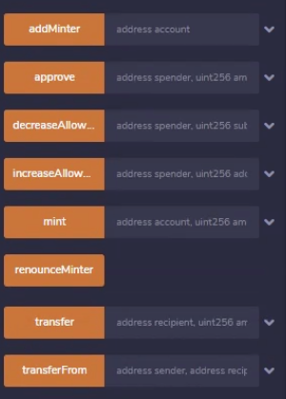
Remix Coding
Constructor
Main Functions
Rate: rate in AngelToken Coins
Wallet: sale beneficiary
Coin: AngelToken, name of the Coin
Goal: goal for crowdsale
Open & close: time Cap
BuyTokens
ClaimRefunds
Finalize
WithdrarTokens
Transfer
Mint

Slide 7
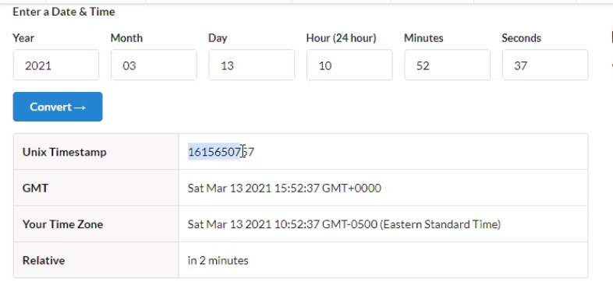
Future Improvement
Can add more functions:
1. Converting time -- Unix Timestamp Conversion Tools
2. Validate the business operation +fraud detection

